Slide 1

Parametric BIM workflows
Dounia Touil, Architect, NSW Arkitektur
DKT 2019

Slide 2
Parametric BIM
Parametric BIM is the convergence of computational design and BIM. Unlike computational design which works with abstract geometries, Parametric BIM engages directly with the BIM model to generate, extract and manipulate data.
Parametric Monkey

Slide 3
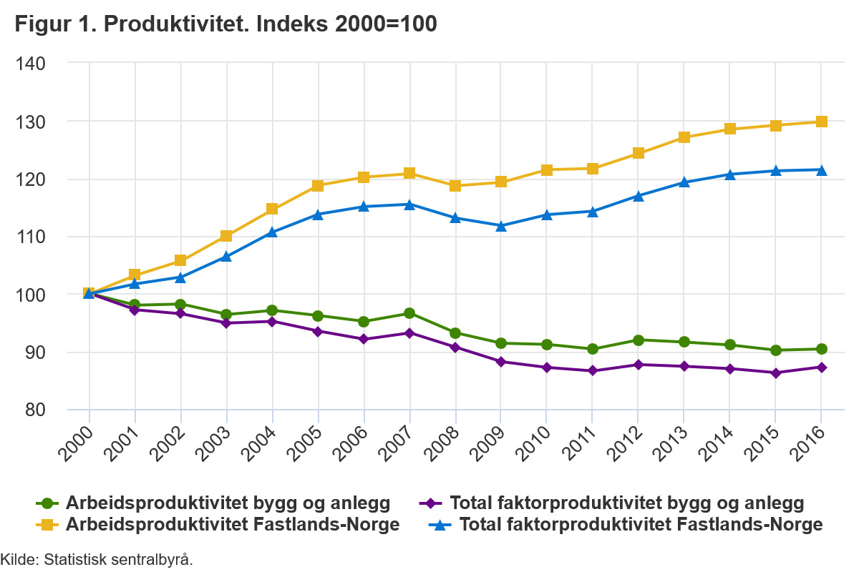
Current state of the AEC industry
AEC: Architecture,
Engineering & Construction

Slide 4
How do we get behind the productivity frontier?

Slide 5
Process
Analyse: your company’s current workflows;
Select: where gains can be made;
Rank: workflows in terms of inneficiencies;
Implement: a new optimized workflow.

Slide 6
Case study
Fylkeshuset, Bergen

Slide 7
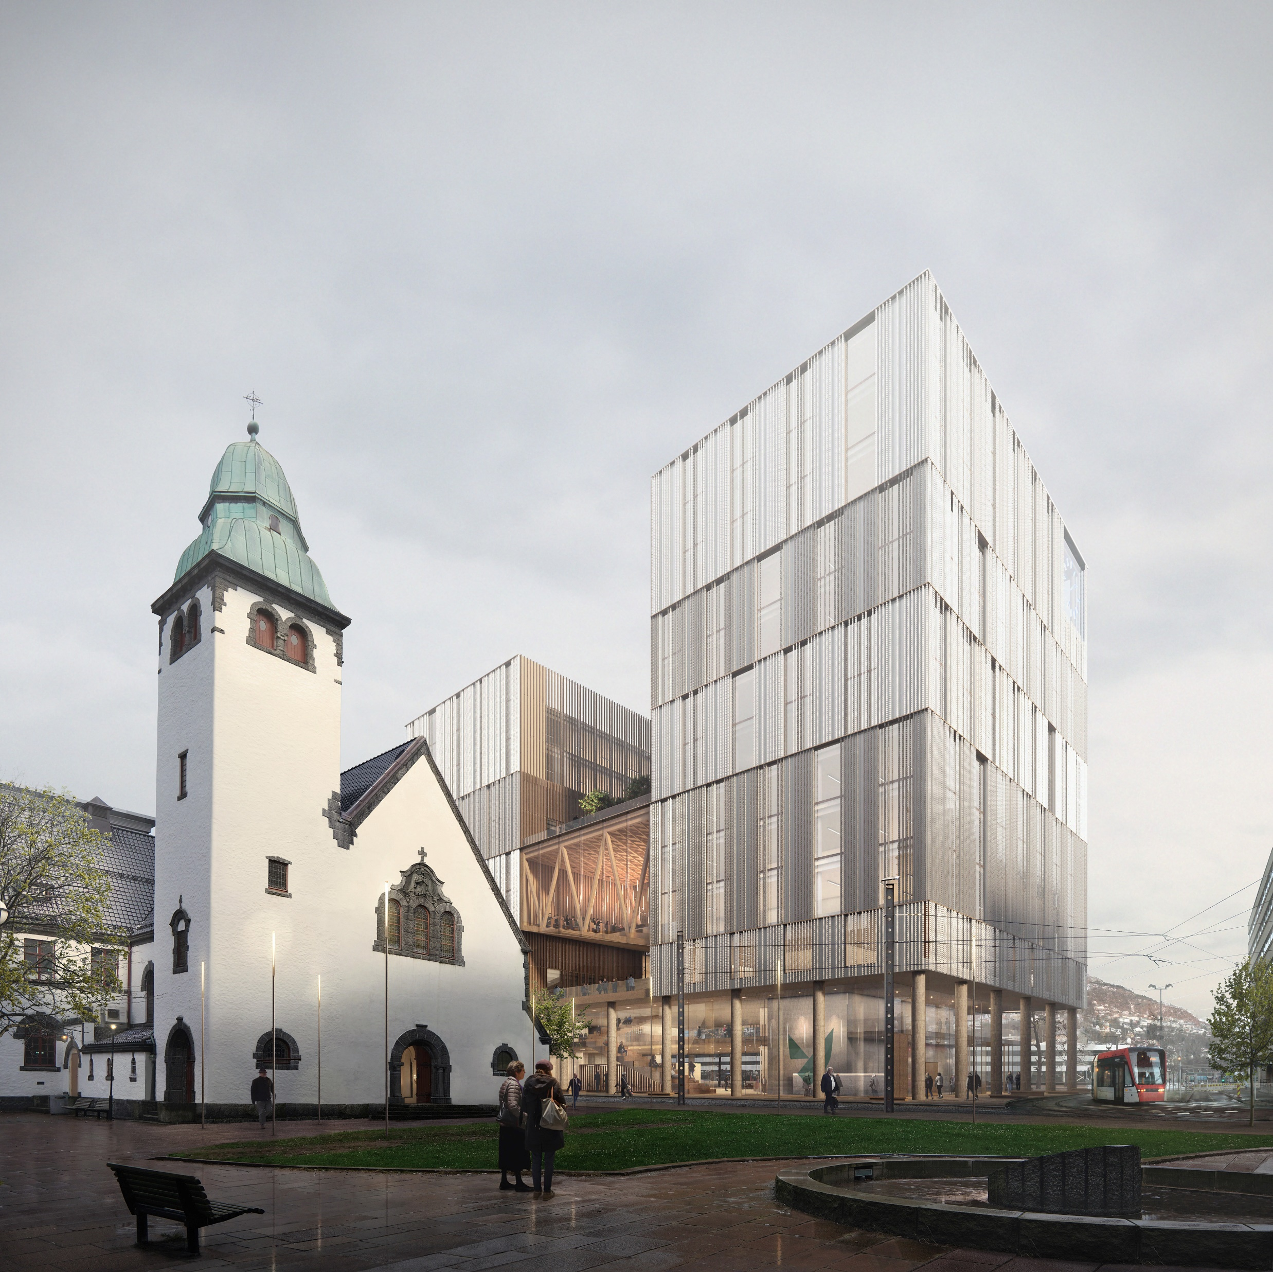
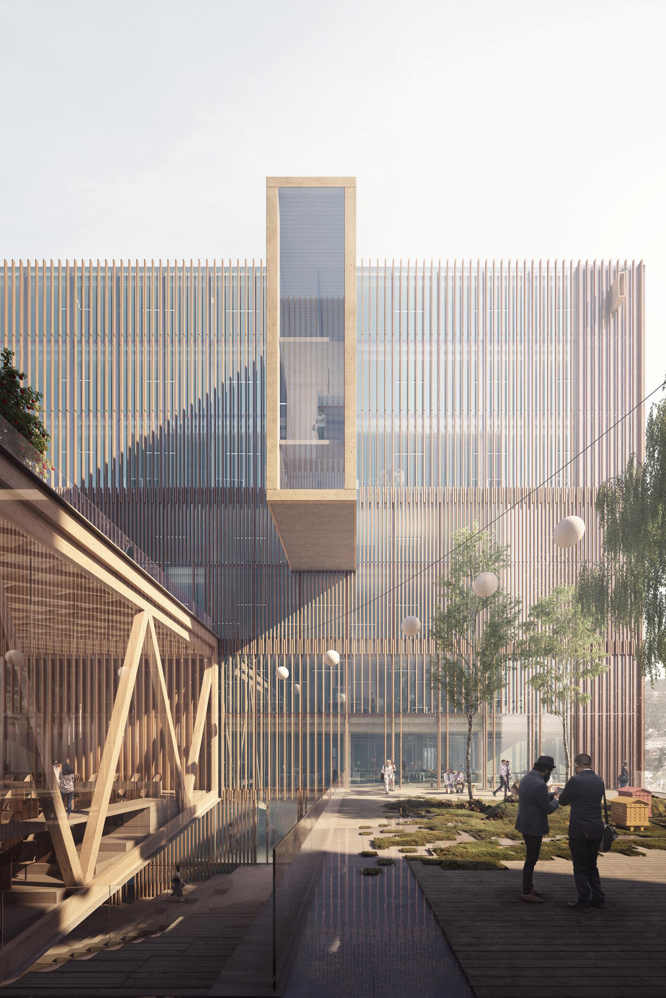
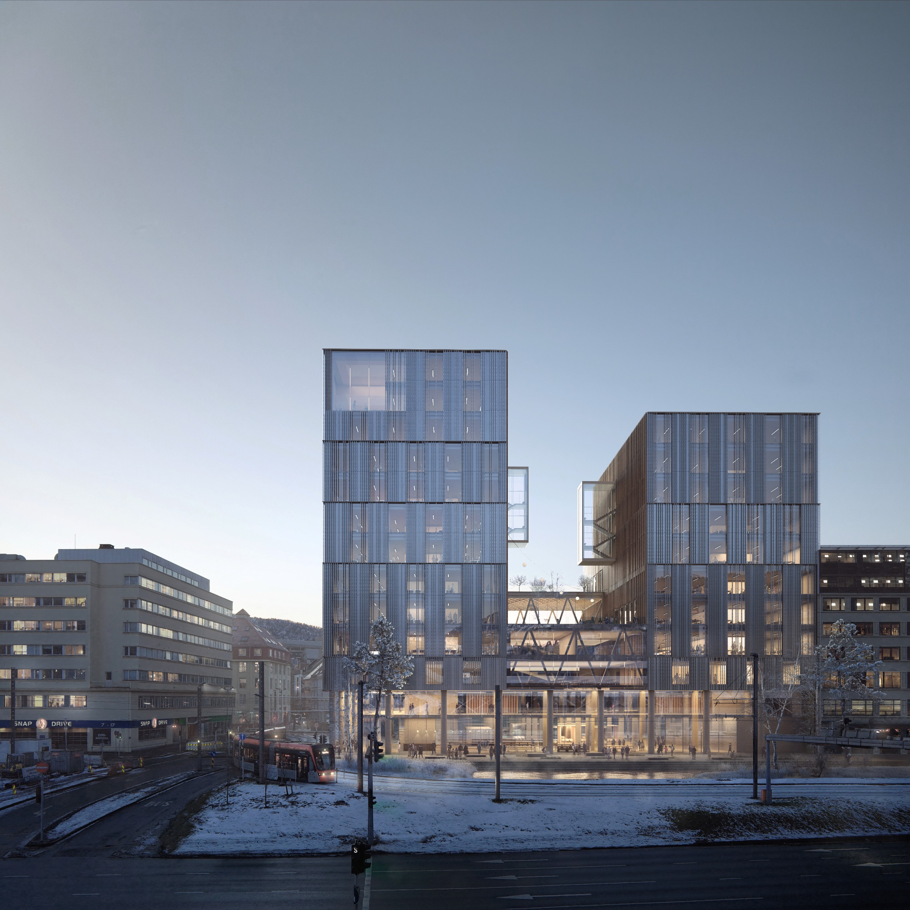
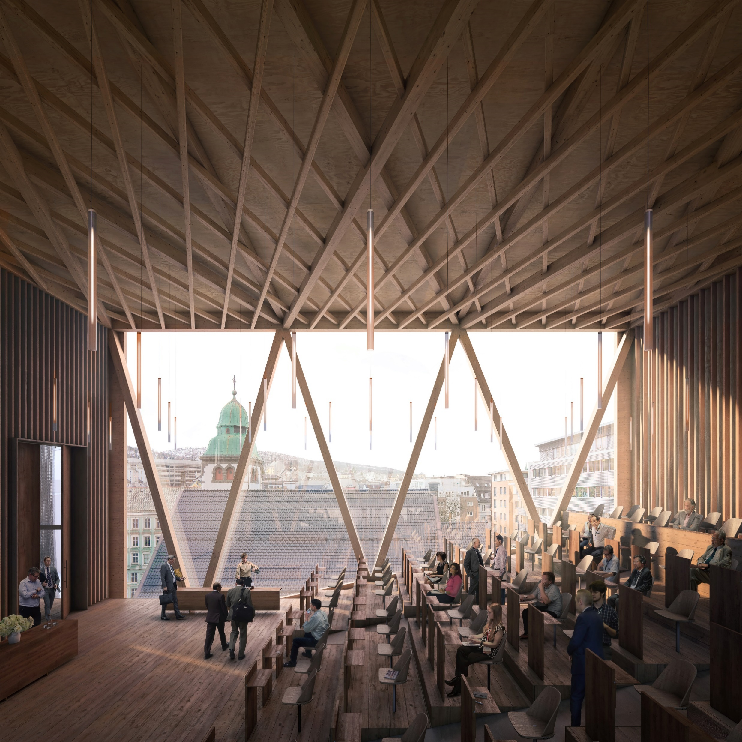

Slide 8
Parametric BIM Workflows
Sketch model
BIM model
Parametric BIM
BIM collaboration
and delivery
ARK
SketchUp
Task automation
Data mining and visualization
Building analysis
Design exploration
Revit
IFC model
Bimsync
Drawings
RIB
RIX
Dynamo
API
Application Programming Interface

Slide 9
How do we get behind the productivity frontier?
How about doing 1 hour work in 1 minute using visual programming?

Slide 10


Slide 11
Conclusion
Problem
Invest in People
Better process
Achieve ROI
Lack of productivity?
Bring a superuser
Improved workflows
Profitability

Slide 12
Thank you
dounia@nsw.no

